Slide 1




Slide 2

Optimal State of living Mobile App

Slide 3
Team members
- Mohammad Gharaibeh (Project Manager)
- Majd Malkawi (Assistant Project Manager)
- Alaa Abushawer (Software Engineer/quality assurance)
- Yousef Hafanawi (UI/UX Designer)

Slide 4
Introduction
Have you ever struggled with managing your mental health?
The Optimal State App provides a seamless way to monitor and improve mental well-being.

Slide 5

Problem Statement
Challenges in mental health tracking and management include :
Limited access to mental health services
Social stigma around mental health
Lack of user-friendly tools

Slide 6
Solution
The Optimal State App addresses these challenges by providing:
- Comprehensive mental health assessments
- Personalized exercises
- A secure platform for remote provider-patient interaction

Slide 7
Key features
- Simple sign-up process
- Color-coded mood assessments
- Customized mental health exercises
- Secure data storage with Firebase
-remote interaction provider

Slide 8
Technology Stack
Development Tools: Visual Studio code ,Android Studio, Firebase
Programming Languages: java with react native framework
Backend: Firebase Firestore database

Slide 9
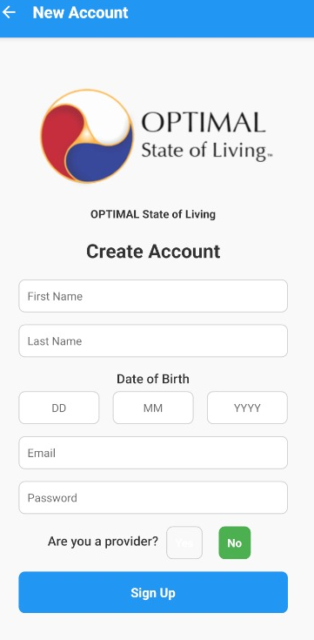
Create Account Screen

Slide 10
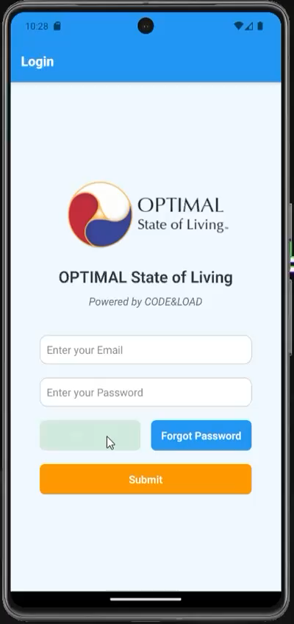
Sign up tutorial

Slide 11

user interface

Slide 12
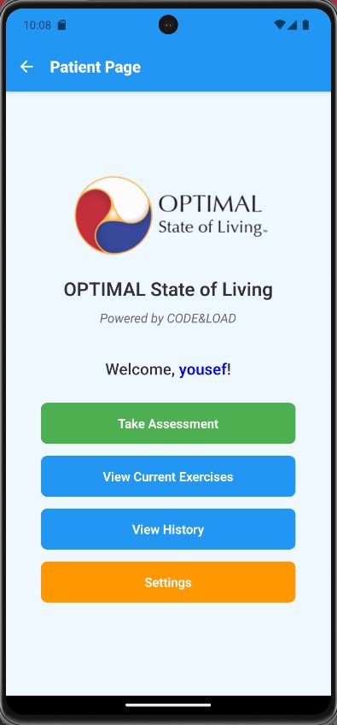
User Page

Slide 13
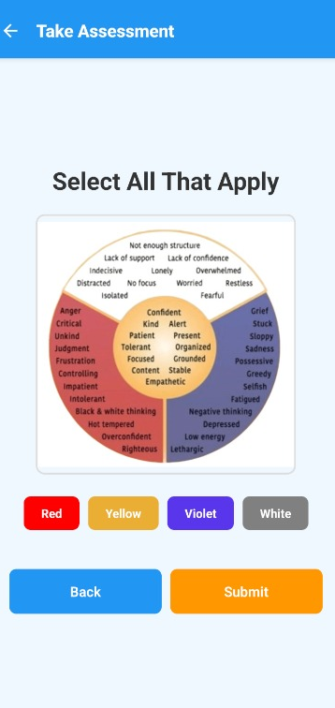
Assessment

Slide 14
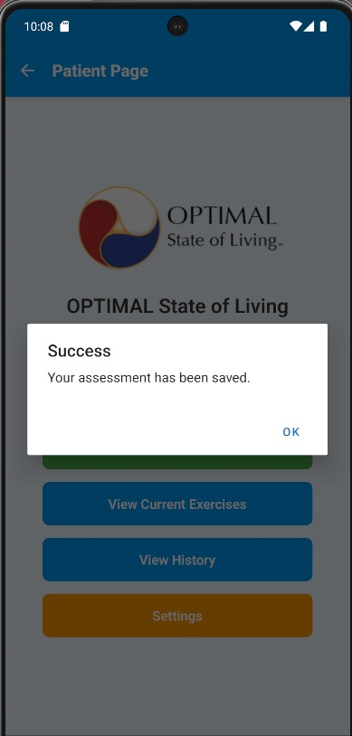
After Assessment

Slide 15
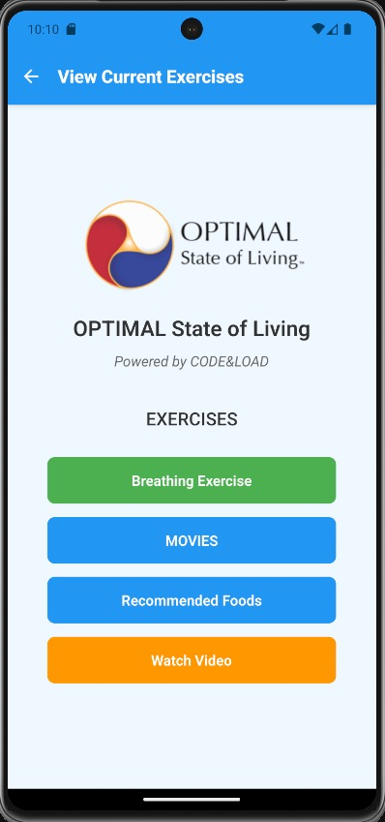
Exercises

Slide 16
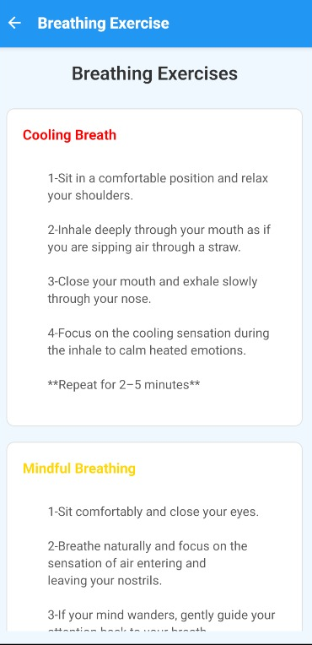
Breathing exercises

Slide 17
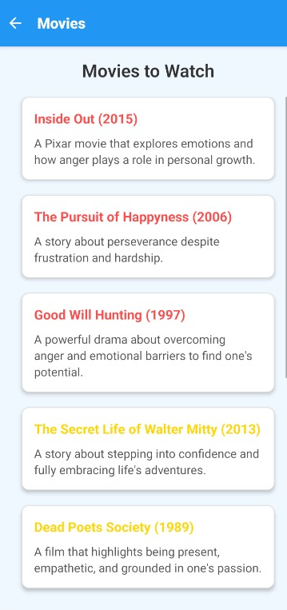
Movies

Slide 18
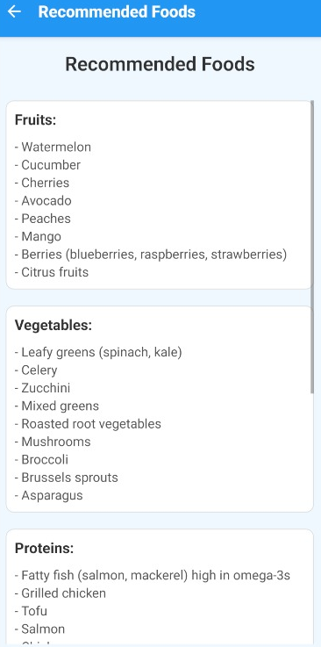
Foods

Slide 19
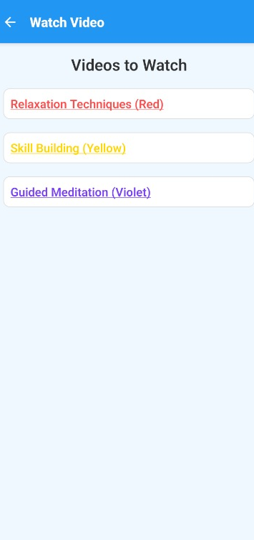
Videos

Slide 20
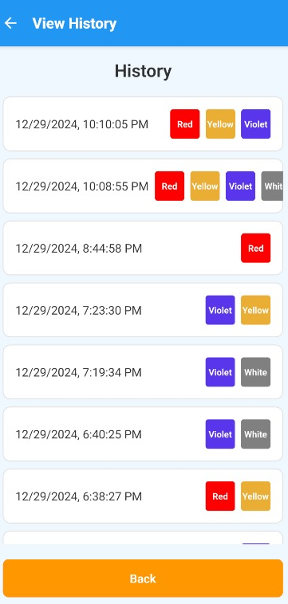
History

Slide 21
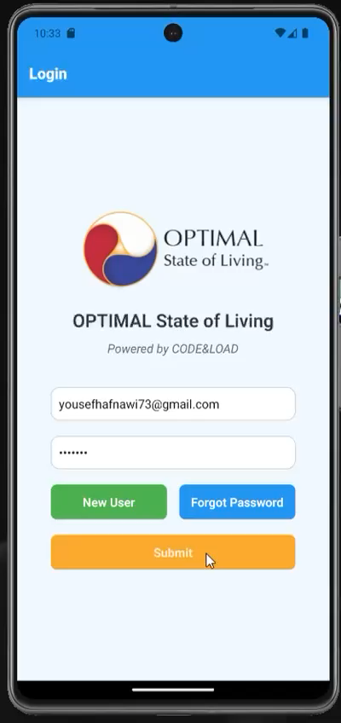
User interface tutorial

Slide 22

Provider interface

Slide 23
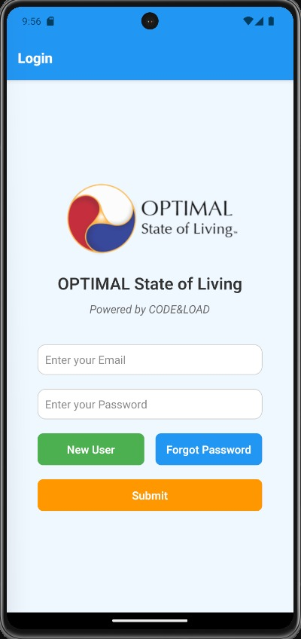
Login Screen

Slide 24
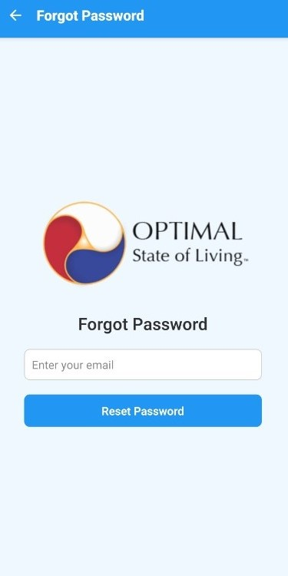
Forget password feature

Slide 25
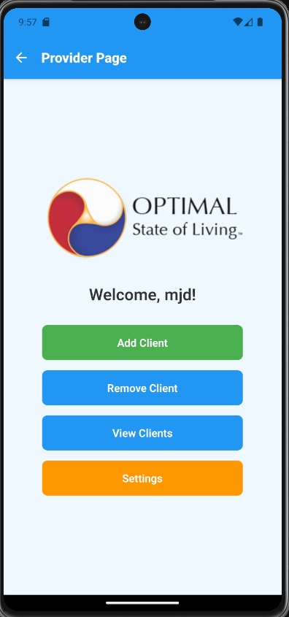
Provider Home page

Slide 26
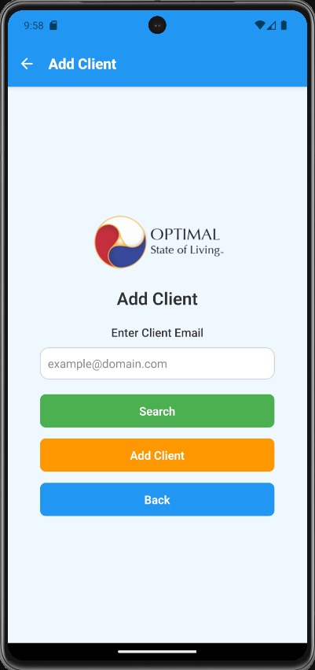
Addition Page

Slide 27
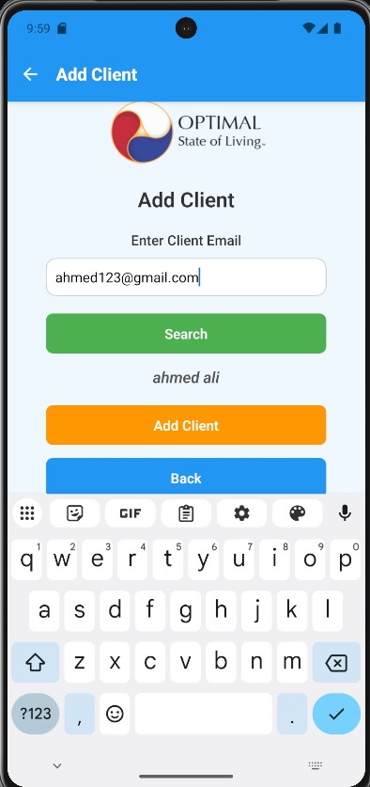
Search button

Slide 28
Client Addition

Slide 29
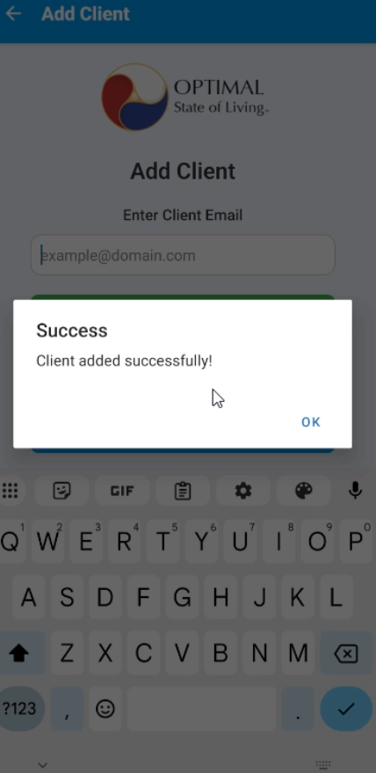
Client Added

Slide 30
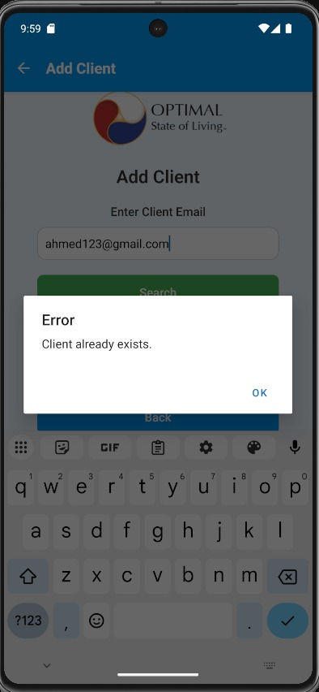
Client already exist_Case

Slide 31
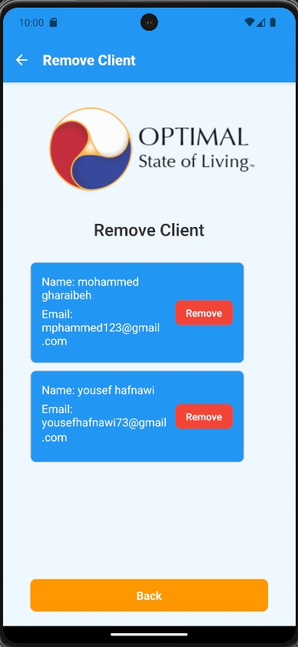
Remove clients

Slide 32
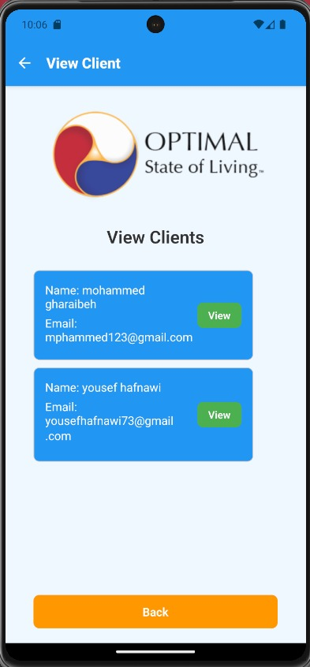
View Clients

Slide 33
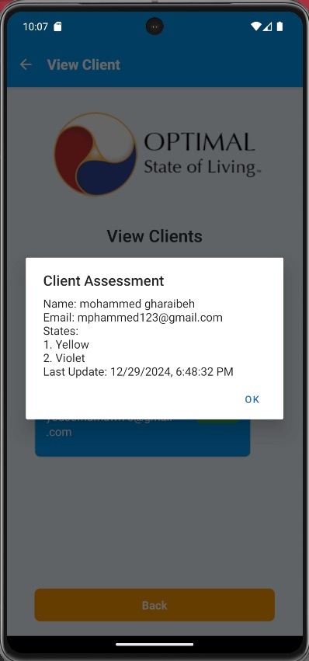
Client Details

Slide 34
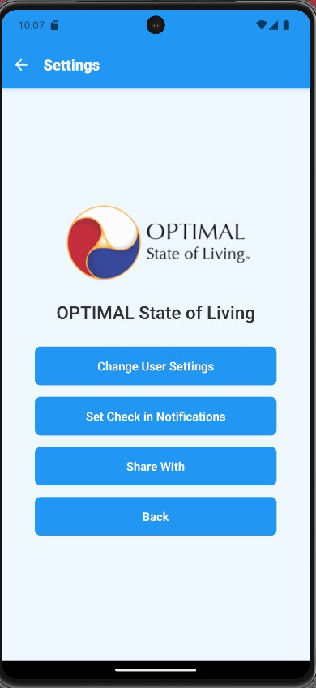
Settings Page

Slide 35
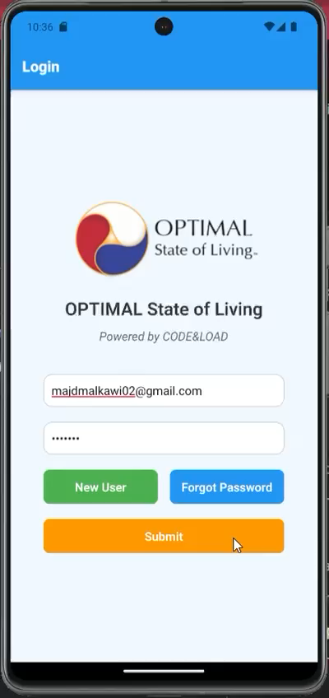
Provider Interface tutorial

Slide 36

BACKEND WORKSPACE

Slide 37
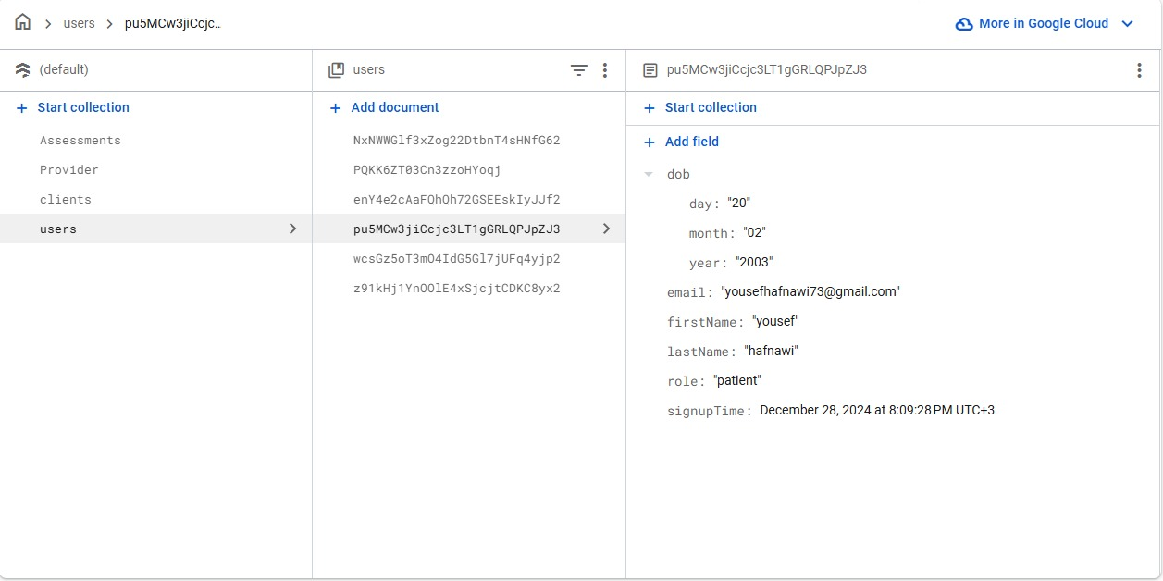

Slide 38
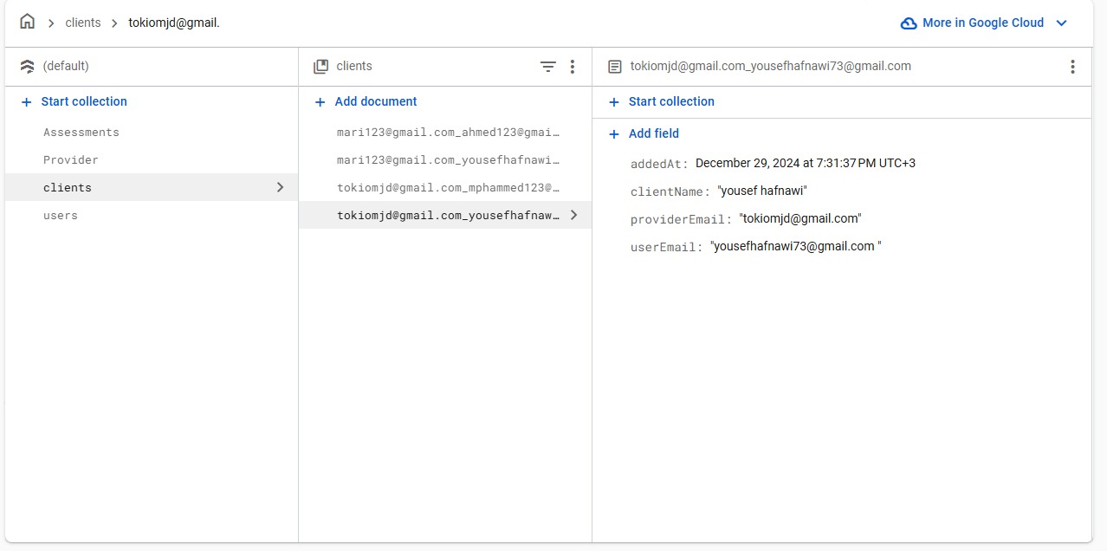

Slide 39
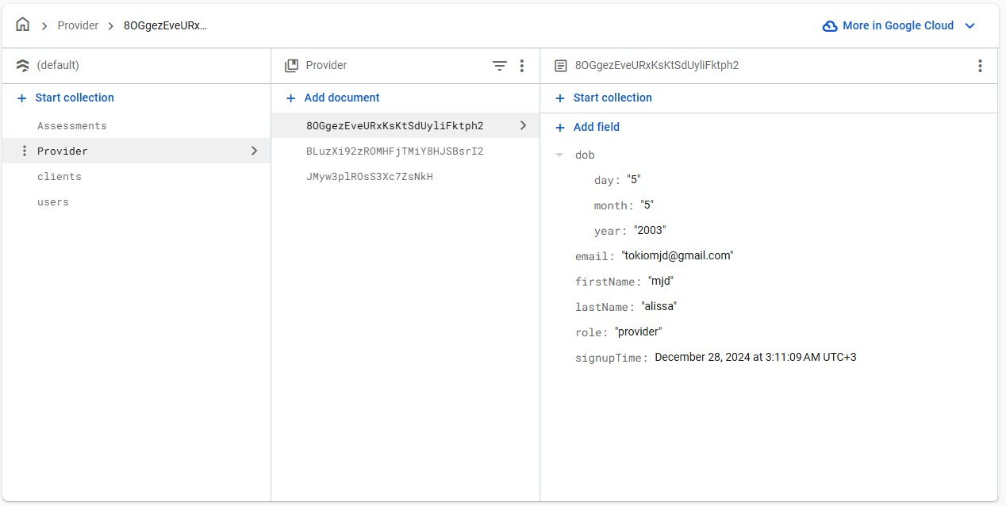

Slide 40
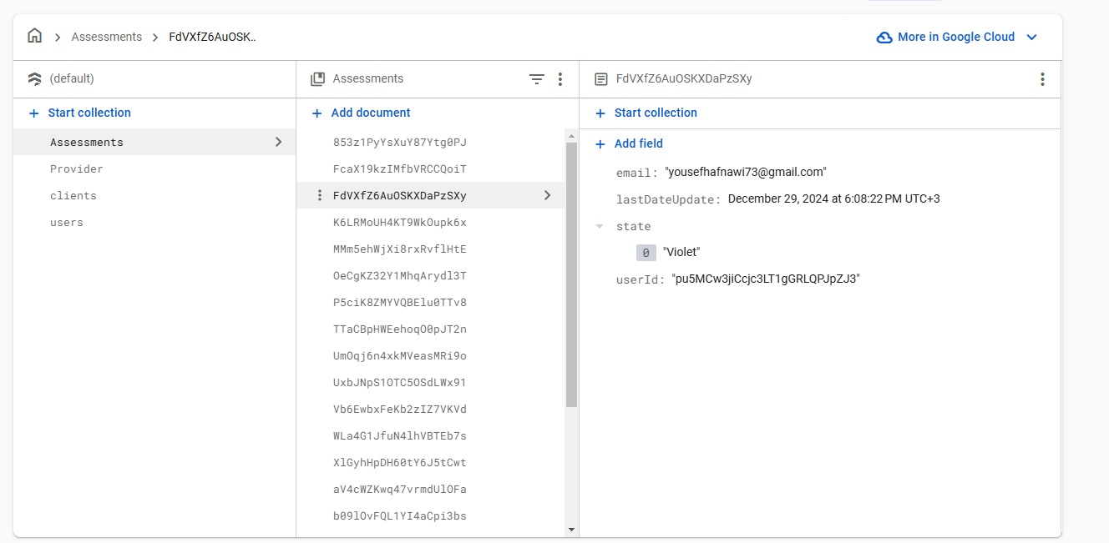

Slide 41
Challenges
- Ensuring quality assurance
- Balancing performance and reliability
- Addressing maintainability with Firebase and react native integration
- Limited team experience in advanced react native components

Slide 42

Thank You
We appreciate your attention and support for the Optimal State of Living App.​

